Slide 1
JOINT STOCK COMPANY
«KALUGA TELETYPES MANUFACTURING PLANT»
248002, Russian Federation, Kaluga, S.-Schedrina str., 141
Tel. (4842) 73-29-60, 56-23-32
Fax: (4842) 73-17-13
E-mail: info@kzta.ru, opp@kzta.ru
www.kzta.ru
General director – Bouhtiyarov L.T.

Slide 2
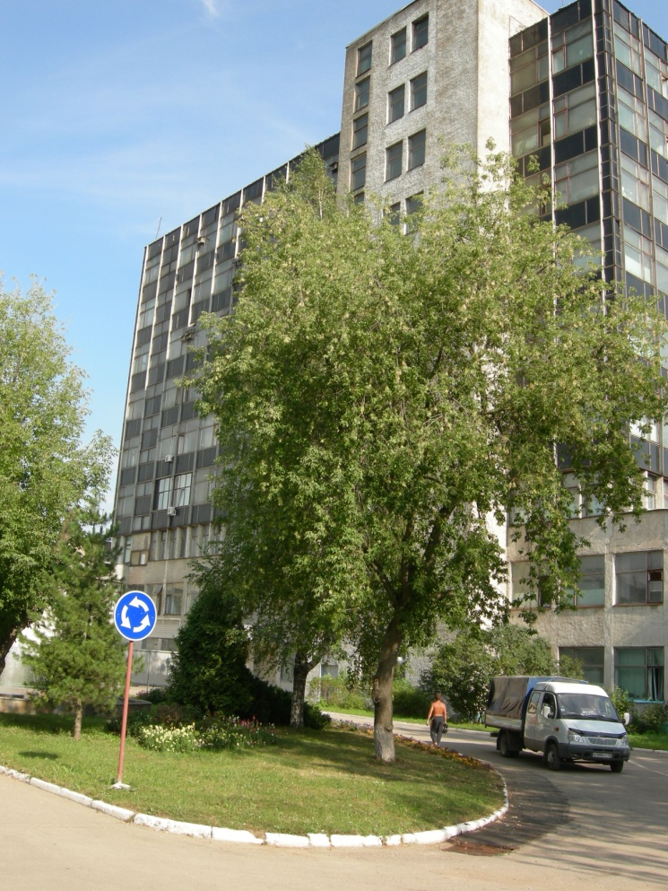
JOINT STOCK COMPANY
«KALUGA TELETYPES MANUFACTURING PLANT»
JSC “Kaluga teletypes manufacturing plant” (JSC “KZTA”) is one of today's growing enterprises with high technical and technological capabilities, with the production index from 60 thousand to 1,5 million pieces a year.
The company is a part of the holding company JSC "Orion Concern" of the State Corporation "Rostekhnologia".
The State Corporation "Rostekhnologia“ is the shareholder of the all shares JSC “KZTA”.
The organization does not have any branches.
Headcount – 1800 employees
The total area occupied by the company is 14.1 ha with structures intended for production, warehouse and administrative premises, with possibility of a new development, the total area under development is 6.9 ha.

Slide 3
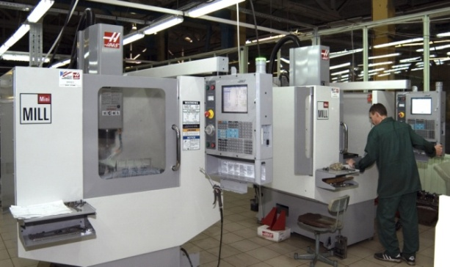
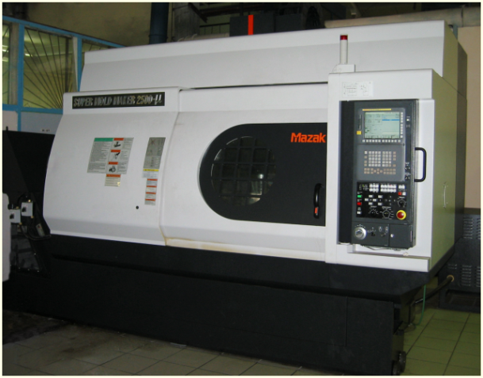
Technological opportunities
JSC “KZTA” have at their command ant necessary types of production facilities, cutting-edge technologies and advanced high-performance equipment which allow the company to perform mass production of electronic and electro-mechanical products.
The principle types of production include:
mechanical and blanking production;
stamping production;
casting production;
assembling production (including assembly of surface-mounted radio elements);
galvanizing and painting production with powder coating process;
laser cutting of metals and moulding of any items using high-performance NC-controlled press equipment;
injection moulding of silastics.

Slide 4
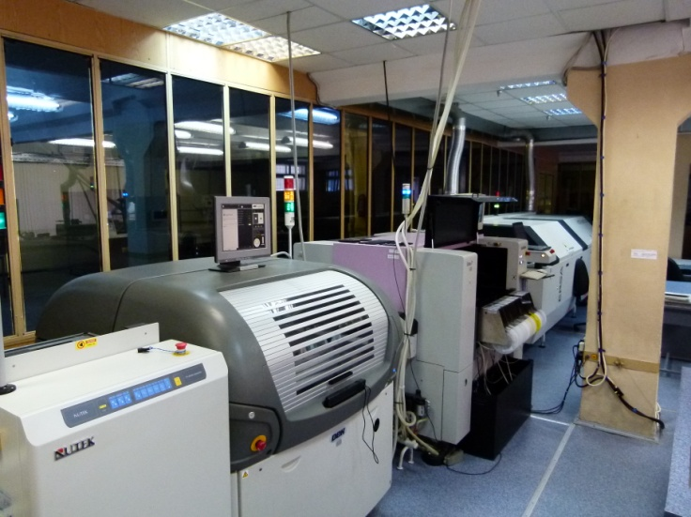
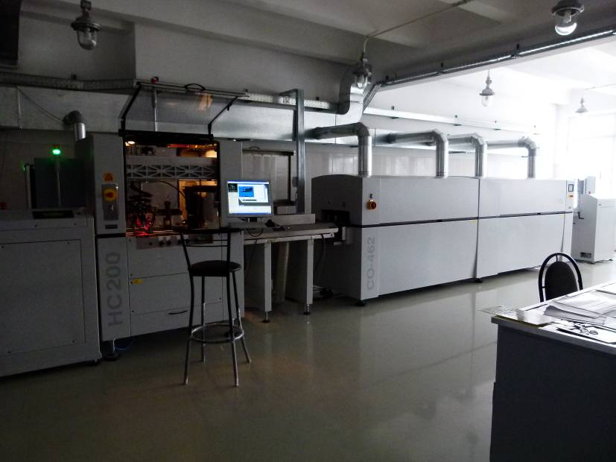
Technological opportunities
The company's machine stock includes the following kinds of equipment:
- an automated line to install surface-mounted items for manufacture of subassemblies, which permits mounting items at space of 0.2 mm , with productivity of 9,500 items per hour,
- units to remove melt and a selective moisture-protection line by Dina,
- an automated optical-injection unit,
- an injection press to manufacture rubber and silicon parts (keyboards), including those with multi-colour areas,
- a stock of automated thermoplastic units with various injection volume (60 to 4,000 cm³) to manufacture body parts,
- advanced milling and turning fabrication centres to manufacture fixtures and hardware (including fabrication centres such as SMV850, MCV500, MINI MILL 560, VM-40 by MАURGAN and FEELER, NC-controlled precision grinding machines ULTRAMAT EAZY CNC by GONES & Shipman (UK), NC-controlled lathes EAGLE-100 by DUGARD, NC-controlled linear lathes Jinn Fa to manufacture various rotational parts, with functions of milling, radial drilling, etc.),

Slide 5
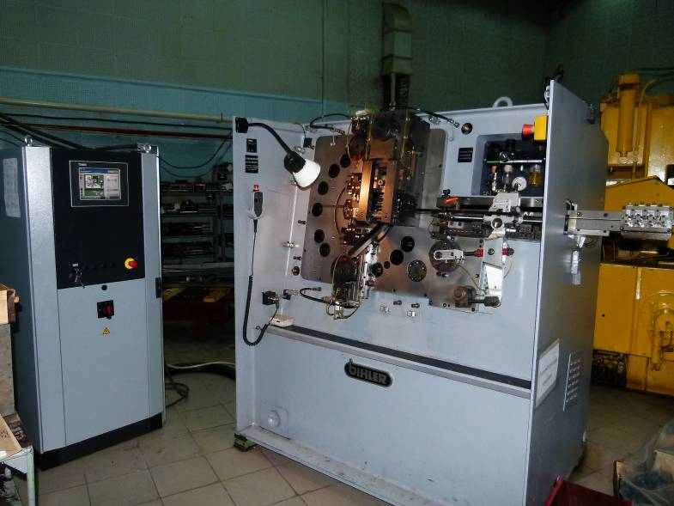
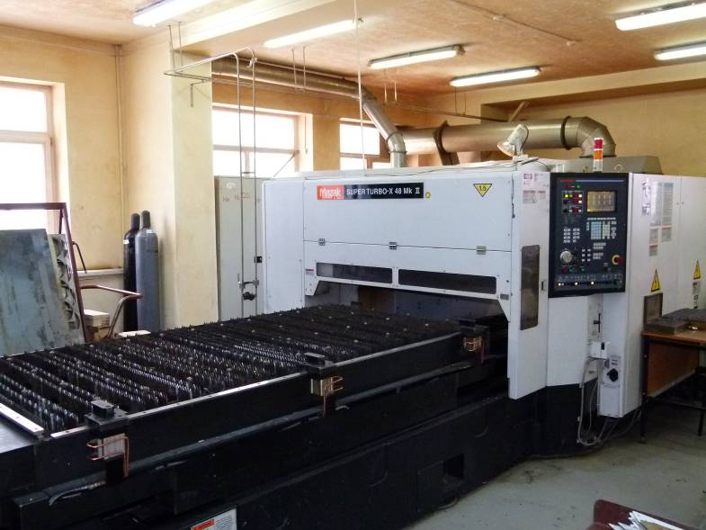
Technological opportunities
- NC-controlled five-axis fabrication centers by Mazak to manufacture complex fixtures (such as working parts of molds, stamps, etc.),
- equipment for mass production of cast bodies of aluminium alloys and plastics, such as a universal stamping automation BIHLER RM-40 to produce various contacts (with capacity up to 400 parts per minute),
- high-speed high-precision СО2 laser machine of series SUPER TURBO-X MARK2 by MАZAK (Japan), with provides quality cutting of metal/steel sheet up to 10 mm thick,
- mechanical and hydraulic presses for three-way fine-blanking, with bench size up to 800x800 mm, and a hydraulic vertical bender DURMA CNC HAP 2580.
The total number of the company's machines is:
2005 units of technological equipment,
3329 units of production equipment.

Slide 6
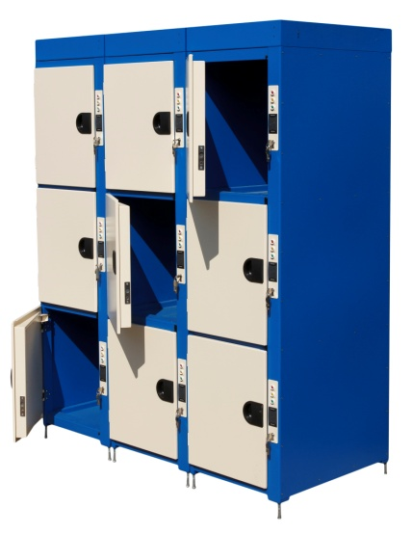
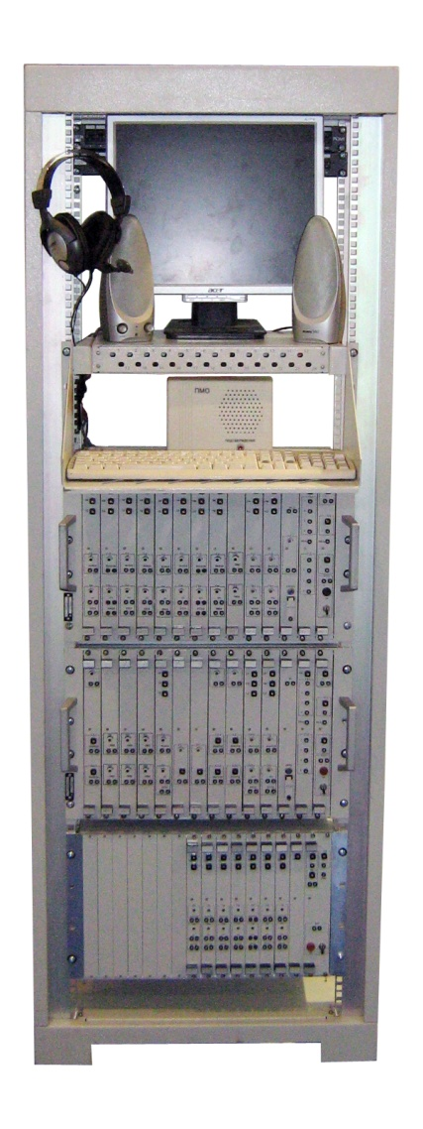
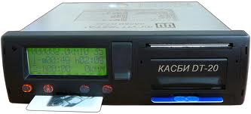
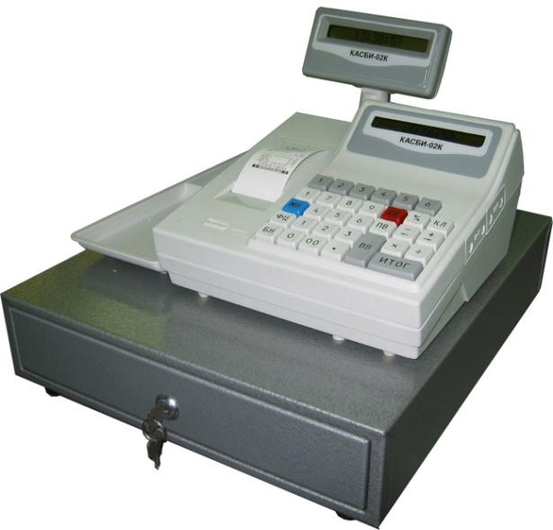
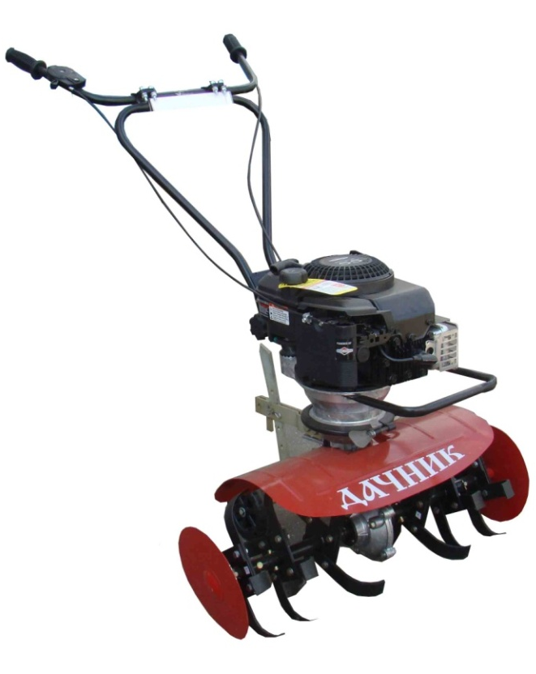
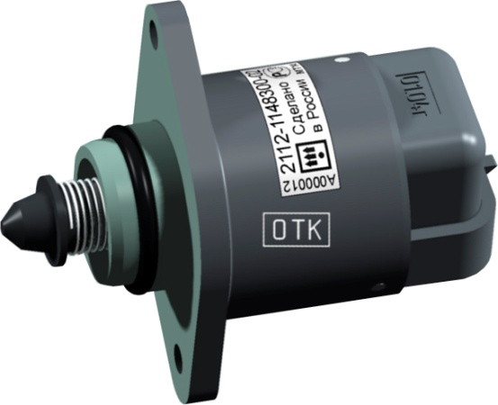
Manufactured products
Product assortment:
- communication hardware to make centralized automatic alert systems of both federal and local levels;
- trading and cash-box equipment for retail and service industries;
- telemetry equipment based on GNS GLONASS: vehicle monitoring systems, digital tachographs, emergency response systems;
- automotive components for conveyor supplies to OJSC AvtoVAZ: idling control units, gear motors, booster resistors, wiring part kits for electromechanical steering boosters;
- automated storage rooms for hand luggage, to be used for services of temporary storage of personal effects and luggage at train stations, airports, sports facilities, etc.;
lawn-and-garden machinery for land ploughing and cultivation – electrical cultivators “Nadezhda”, motorized cultivators “Rusich”.

Slide 7
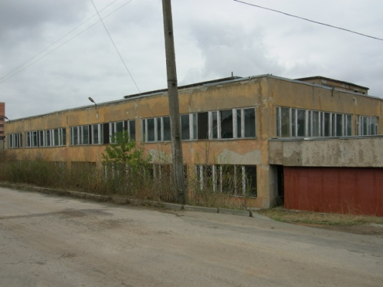
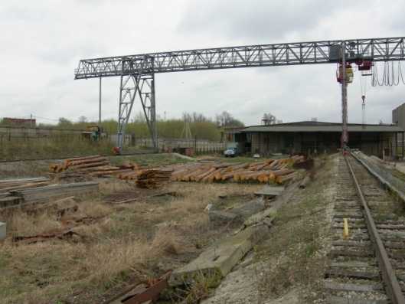
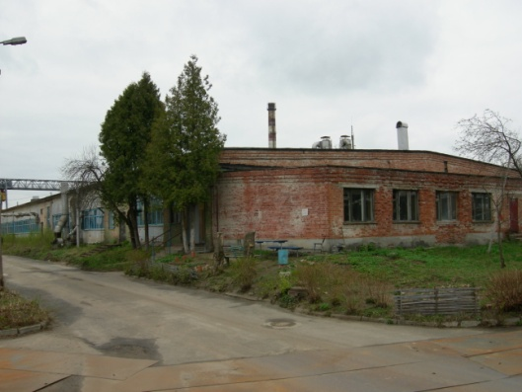
Infrastructure
For purpose of establishing a joint venture or transferring in long-term lease, JSC Kaluga Teletypes Manufacturing Plant (JSC KZTA) offers administrative and production premises with the floor area up to 2,500 sq. m., and a land plot with the area of 3.125 ha, with structures for production, warehouse and administrative premises, with possibility of a new development, which are located in the company's territory at: Kaluga, Ul. Saltykova-Schedrina, 141.
Close location to science and technology parks Grabtsevo and Vorsino, and the Volvo Plant.
Available service and utility lines.
Convenient access for motor vehicles as distance to the Kaluga Belt Highway is 500 meters.
Opportunity to use railway transport – there are railway tracks available that require repairs.
The unloading ground with a handling machine.
24-hour security.

Slide 8
Free capacities
Potential partners can be offered the following free capacities:
Electric power up to 2,000 kW
Water supply up to 100 thousand m³/year
Heat in a form of hot water with parameters of 150 ⁰С – 70 ⁰С with reduction 120 ⁰С – 10 Gcal/hour
Gas supplies (natural gas under pressure of 0.2-2.5 kg/cm²) – up to 2,000 nm³/hour
Process steam at temperature of 230 ⁰С and pressure of 3.0 – 10.0 kg/cm² – 8.0 tons/hour during summer and 15.0 tons/hour during winter
Treated compressed air under pressure of 5.0 kg/cm² - up to 10.0 m³/min
Water discharge: sewerage – up to 100 thousand m³/year
storm-water sewerage – up to 120 thousand m³/year

Slide 9
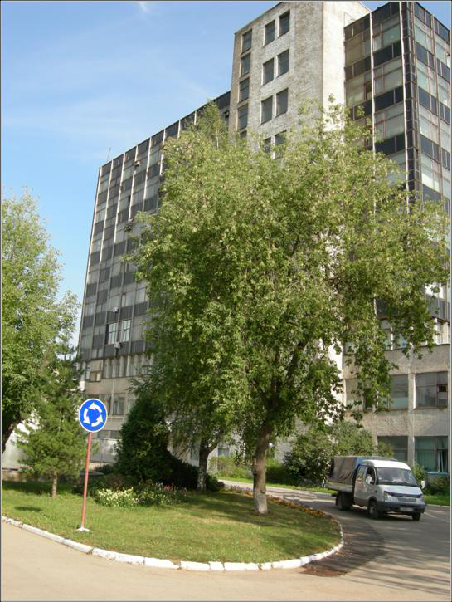
JOINT STOCK COMPANY
«KALUGA TELETYPES MANUFACTURING PLANT»
JSC “Kaluga teletypes manufacturing plant” is ready to consider any offers of cooperation.
Depending on a scale of a project, and if interested in long-term cooperation, areas offered may be increased.
Expectation from partners is industrial cooperation with the existing production.
248002, Russian Federation, Kaluga, S.-Schedrina str., 141
Tel. +7 (4842) 73-29-72, 73-25-84 Fax +7 (4842) 73-17-13
E-mail: marketing@kzta.ru www.kzta.ru

